Slide 1
Lecture 08: Syntactic Analysis (Parsing)
Lecture 08 - Syntax Analyser

Slide 2
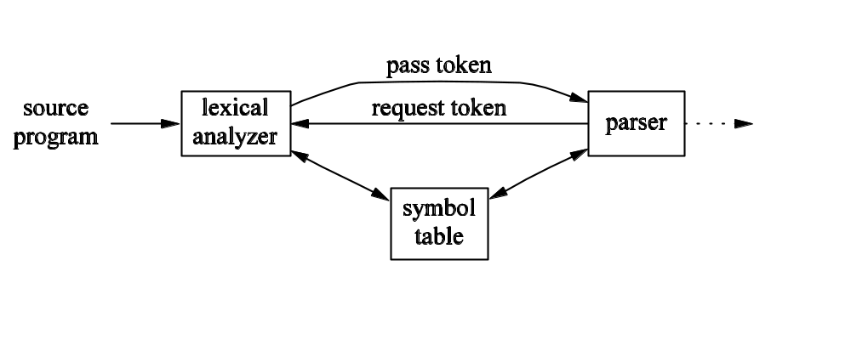
Lexical Analyzer and Parser
Lecture 08 - Syntax Analyser

Slide 3
Parser
Accepts string of tokens from lexical analyzer (usually one token at a time)
Verifies whether or not string can be generated by grammar
Reports syntax errors (recovers if possible)
Lecture 08 - Syntax Analyser

Slide 4
Errors
Lexical errors (e.g. misspelled word)
Syntax errors (e.g. unbalanced parentheses, missing semicolon)
Semantic errors (e.g. type errors)
Logical errors (e.g. infinite recursion)
Lecture 08 - Syntax Analyser

Slide 5
Error Handling
Report errors clearly and accurately
Recover quickly if possible
Poor error recover may lead to avalanche of errors
Lecture 08 - Syntax Analyser

Slide 6
Error Recovery
Panic mode: discard tokens one at a time until a synchronizing token is found
Phrase-level recovery: Perform local correction that allows parsing to continue
Error Productions: Augment grammar to handle predicted, common errors
Global Production: Use a complex algorithm to compute least-cost sequence of changes leading to parseable code
Lecture 08 - Syntax Analyser

Slide 7
Context Free Grammars
CFGs can represent recursive constructs that regular expressions can not
A CFG consists of:
  Tokens (terminals, symbols)
  Nonterminals (syntactic variables denoting sets of strings)
  Productions (rules specifying how terminals and nonterminals can combine to form strings)
  A start symbol (the set of strings it denotes is the language of the grammar)
Lecture 08 - Syntax Analyser

Slide 8
Derivations (Part 1)
One definition of language: the set of strings that have valid parse trees
Another definition: the set of strings that can be derived from the start symbol
E → E + E | E * E | (E) | – E | id
E => -E (read E derives –E)
E => -E => -(E) => -(id)
Lecture 08 - Syntax Analyser

Slide 9
Derivations (Part 2)
αAβ => αγβ if A → γ is a production and α and β are arbitrary strings of grammar symbols
If a₁ => a₂ => … => a_{n}, we say a₁ derives a_{n}
=> means derives in one step
*=> means derives in zero or more steps
⁺=> means derives in one or more steps
Lecture 08 - Syntax Analyser

Slide 10
Sentences and Languages
Let L(G) be the language generated by the grammar G with start symbol S:
  Strings in L(G) may contain only tokens of G
  A string w is in L(G) if and only if S ⁺=> w
  Such a string w is a sentence of G
Any language that can be generated by a CFG is said to be a context-free language
If two grammars generate the same language, they are said to be equivalent
Lecture 08 - Syntax Analyser

Slide 11
Sentential Forms
If S *=> α, where α may contain nonterminals, we say that α is a sentential form of G
A sentence is a sentential form with no nonterminals
Lecture 08 - Syntax Analyser

Slide 12
Leftmost Derivations
Only the leftmost nonterminal in any sentential form is replaced at each step
A leftmost step can be written as wAγ _{lm}=> wδγ
  w consists of only terminals
  γ is a string of grammar symbols
If α derives β by a leftmost derivation, then we write α _{lm}*=> β
If S _{lm}*=> α then we say that α is a left-sentential form of the grammar
Analogous terms exist for rightmost derivations
Lecture 08 - Syntax Analyser

Slide 13
Parse Trees
A parse tree can be viewed as a graphical representation of a derivation
Every parse tree has a unique leftmost derivation (not true of every sentence)
An ambiguous grammars has:
  more than one parse tree for at least one sentence
  more than one leftmost derivation for at least one sentence
Lecture 08 - Syntax Analyser

Slide 14
Capability of Grammars
Can describe most programming language constructs
An exception: requiring that variables are declared before they are used
  Therefore, grammar accepts superset of actual language
  Later phase (semantic analysis) does type checking
Lecture 08 - Syntax Analyser

Slide 15
Regular Expressions vs. CFGs
Every construct that can be described by an RE and also be described by a CFG
Why use REs at all?
  Lexical rules are simpler to describe this way
  REs are often easier to read
  More efficient lexical analyzers can be constructed
Lecture 08 - Syntax Analyser

Slide 16
Verifying Grammars
A proof that a grammar verifies a language has two parts:
  Must show that every string generated by the grammar is part of the language
  Must show that every string that is part of the language can be generated by the grammar
Rarely done for complete programming languages!
Lecture 08 - Syntax Analyser

Slide 17
Eliminating Ambiguity (1)
stmt → if expr then stmt
| if expr then stmt else stmt
| other
if E₁ then if E₂ then S₁ else S₂
Lecture 08 - Syntax Analyser

Slide 18
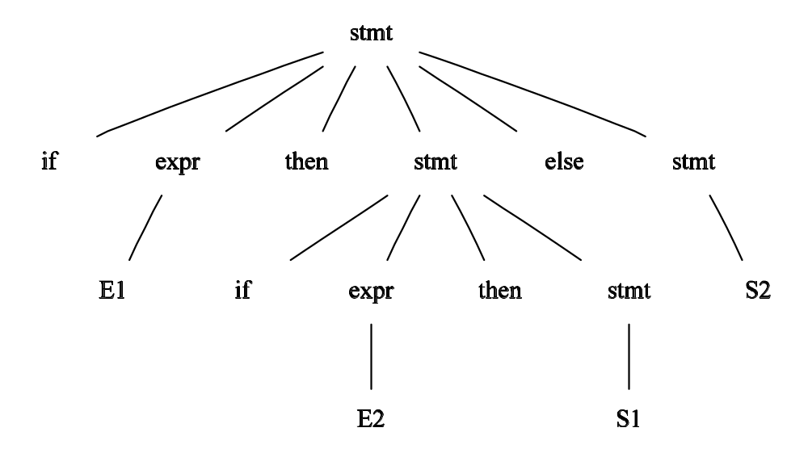
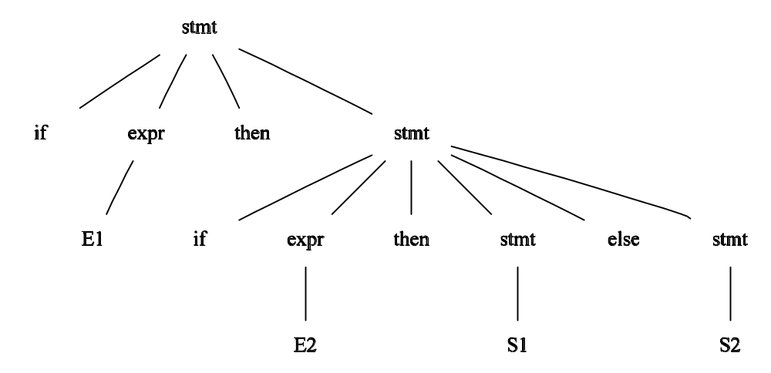
Eliminating Ambiguity (2)
Lecture 08 - Syntax Analyser

Slide 19
Eliminating Ambiguity (3)
stmt → matched
| unmatched
matched → if expr then matched else matched
| other
unmatched → if expr then stmt
| if expr then matched else unmatched
Lecture 08 - Syntax Analyser

